Slide 1
Simple program to find the factorial of a number
#include <stdio.h>
#include<conio.h>
int main()
{
int n, i;
long int fact = 1;
printf("Enter an integer: ");
scanf("%d",&n);
if (n < 0)
printf(“wrong input");
else
{
for(i=1; i<=n; ++i)
{
fact = fact *i;
}
printf("Factorial is %ld, fact);
} return 0; }

Slide 2
Unit-3
Functions and arrays

Slide 3
Function
A function is a group of statements that together perform a task.
OR
A function is a block of code that performs a particular task.
Every C program has at least one function, which is main()
There are many situations where we might need to write same line of code for more than once in a program. This may lead to unnecessary repetition of code, bugs and even becomes boring for the programmer. So, C language provides an approach in which you can declare and define a group of statements once in the form of a function and it can be called and used whenever required.

Slide 4
Benefits of Using Functions
It provides modularity to your program's structure.
It makes your code reusable. You just have to call the function by its name to use it, wherever required.
In case of large programs with thousands of code lines, debugging and editing becomes easier if you use functions.
It makes the program more readable and easy to understand.

Slide 5
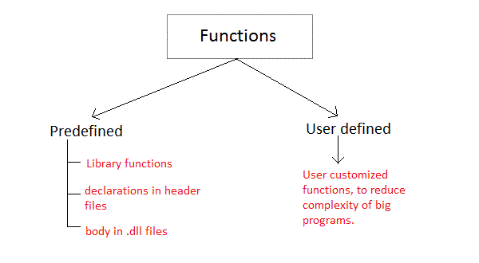

Slide 6
Library functions or in built functions or pre defined functions are those functions which are already defined in C library, example printf(), scanf(). You just need to include appropriate header files to use these functions. These are already declared and defined in C libraries.
A User-defined functions on the other hand, are those functions which are defined by the user at the time of writing program. These functions are made for code reusability and for saving time and space.

Slide 7
Function declaration(function prototype)
Syntax:
Returntype function name(datatype1 parameter1,datatypetype2 parameter2,..);
Function declaration informs the compiler about the function name, parameters is accept, and its return type.

Slide 8
Function declaration consists of parts.
  returntype
  function name
  parameter list
Returntype:: When a function is declared to perform some sort of calculation or any operation and is expected to provide with some result at the end, in such cases, a return statement is added at the end of function body.
Return type specifies the type of value(int, float, char, double) that function is expected to return to the program which called the function.
Note: In case your function doesn't return any value, the return type would be void.

Slide 9
2. Function name is an identifier and it specifies the name of the function. The function name is any valid C identifier and therefore must follow the same naming rules like other variables in C language.
3. Parameter list::The parameter list declares the type and number of arguments that the function expects when it is called. Also, the parameters in the parameter list receives the argument values when the function is called. They are often referred as formal parameters.

Slide 10
Calling a function
While creating a C function, you give a definition of what the function has to do. To use a function, you will have to call that function to perform the defined task.
When a program calls a function, the program control is transferred to the called function. A called function performs a defined task and when its return statement is executed or when its function-ending closing brace is reached, it returns the program control back to the main program.
To call a function, you simply need to pass the required parameters along with the function name, and if the function returns a value, then you can store the returned value.

Slide 11
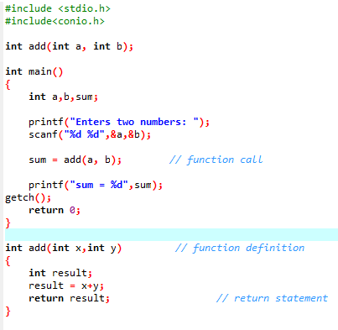

Slide 12
Pass arguments/parameters
There are two ways to pass value or data to function in C language:
  call by value
  call by reference
Original value is not modified in call by value but it is modified in call by reference.

Slide 13
Call by value
A copy of actual arguments is made and stored at other location in computer memory known as formal arguments. The changes are made in formal arguments not in the actual arguments.

Slide 14
Call by value
#include<stdio.h>
#include<conio.h>
void swap(int a,int b);
int main()
{
int a,b;
printf("Enter numbers");
scanf("%d%d",&a,&b);
swap(a,b);
getch();
return 0;
}
void swap(int x,int y)
{
int temp;
temp = x;
x=y;
y=temp;
Printf(“swapped values are %d %d”,x,y);
}

Slide 15
Call by reference
original value is modified because we pass reference (address).
Actual arguments are copied and then assigned to the corresponding formal arguments. Now formal and actual arguments both points to the same data (because they contain the same address).
If data is passed by reference, a pointer to the data is copied instead of the actual variable as is done in a call by value. Because a pointer is copied, if the value at that pointers address is changed in the function, the value is also changed in main().

Slide 16
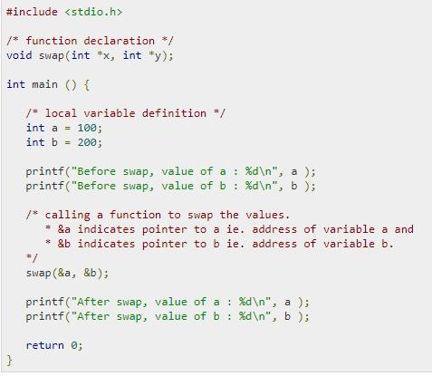
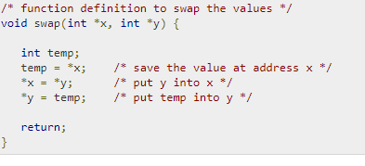

Slide 17
Call by value
Call by reference
A copy of value is passed to the function
Changes made inside the function is not reflected on other functions
Actual and formal arguments will be created in different memory location
Actual argument can be variable and constant.
An address of value is passed to the function
Changes made inside the function is reflected outside the function also
Actual and formal arguments will be created in same memory location
Actual argument can only be variable.

Slide 18
Recursion
When function is called within the same function, it is known as recursion in C. The function which calls the same function, is known as recursive function.
A function that calls itself, and doesn't perform any task after function call, is know as tail recursion. In tail recursion, we generally call the same function with return statement.
Syntax::
Recursion function()
{
Recursion function();//calling self function
}

Slide 19
Fact using recursion
else
{
f = factorial(n);
printf("%ld”, f);
}
getch();
return 0;
}
int factorial(int x)
{
if (x == 0)
return 1;
else
return(x * factorial(x-1));
}
#include<stdio.h>
#include<conio.h>
int factorial(int n);
int main()
{
int n;
long f;
printf("Enter an integer to find its factorial\n");
scanf("%d",&n);
if (n < 0)
printf("Factorial of negative integers isn't defined.\n");

Slide 20
Array
An array is a data structure that contains a group of elements. Typically these elements are all of the same data type, such as an integer or string.
Arrays are commonly used in computer programs to organize data so that a related set of values can be easily sorted or searched.
Arrays are Collection of Elements having same name and same data type But Always Remember Arrays Always Start From its index value and the index of array goes From 0 to n-1.

Slide 21
Suppose we wants to Access 5th Element of array then we will use 4th Element Because Arrays are Start From 0 and arrays are always stored in Continuous Memory Locations.
A dimensional is used representing the elements of the array
for example
Data_type array_name [size];
Int a[5];

Slide 22
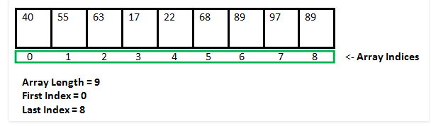
Syntax= Datatype array_name [dimensions] ={element1,element2,….,element}

Slide 23
In C, we can declare an array by specifying its type and size or by initializing it or by both.
1. Array declaration by specifying size
int arr[10];
2. Array declaration by initializing elements
int arr[] = {10, 20, 30, 40}
// Compiler creates an array of size 4.
// above is same as "int arr[4] = {10, 20, 30, 40}"
3. Array declaration by specifying size and initializing
//elements
int arr[6] = {10, 20, 30, 40}
Compiler creates an array of size 6, initializes first
4 elements as specified by user and rest two elements as 0.
above is same as "int arr[] = {10, 20, 30, 40, 0, 0}"

Slide 24
Array elements are accessed by using an integer index. Array index starts with 0 and goes till size of array minus 1.

Slide 25
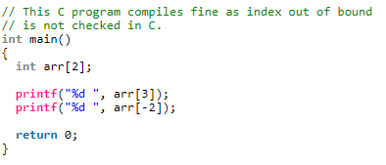
No Index Out of bound Checking:
There is no index out of bound checking in C, for example the following program compiles fine but may produce unexpected output when run.
Also, In C, it is not compiler error to initialize an array with more elements than specified size.

Slide 26
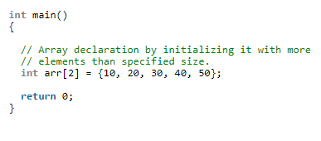
The program won’t compile, it will generate error: too many initializers for ‘int [2]'”.

Slide 27
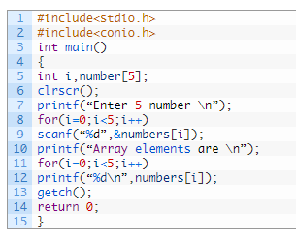
Read and display an elements of array

Slide 28
int main()
{
int i, a[5], sum=0;
printf("\n Enter the values :");
for (i = 0; i < 5; i++)
{
scanf("%d", &a[i]);
}
for (i = 0; i < 5; i++)
sum = sum + a[i];
printtf("Sum=%d", sum);
return (0);
}

Slide 29
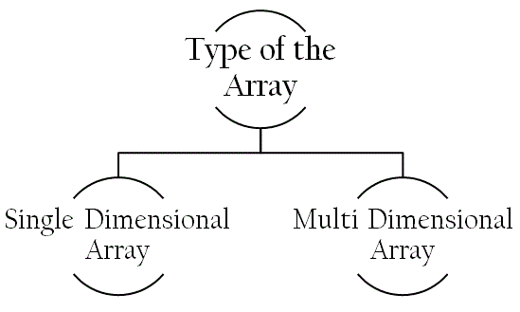
Array types

Slide 30
Single Dimensional array
Single or One Dimensional array is used to represent and store data in a linear form.
Array having only one subscript variable is called One-Dimensional array
It is also called as Single Dimensional Array or Linear Array
Syntax: <data-type> <array_name> [size];
Ex- int iarr[3] = {2, 3, 4};
  char carr[20] = "c4learn" ;
  float farr[3] = {12.5,13.5,14.5} ;

Slide 31
Multi Dimensional Array :
Array having more than one subscript variable is called Multi-Dimensional array.
Multi Dimensional Array is also called as Matrix.
The 2-D arrays are used to store data in the form of table. We also use 2-D arrays to create mathematical matrices.
Syntax:: <data-type> <array_name> [row_subscript][column-subscript];

Slide 32
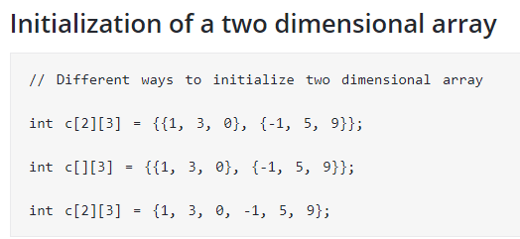

Slide 33
Store and display elements entered by user in a 2d array
#include<stdio.h>
#include<conio.h>
int main()
{
int arr[2][2], i,j;
printf("\n Enter elements");
for (i = 0; i < 2; i++)
{
for(j=0;j<2;j++)
{
scanf("%d", &arr[i][j]);
} }
printf(“elements are”);
for (i = 0; i < 2; i++)
{
For(j=0;j<2;j++)
{
printf("\n %d", arr[i][j]);
}
getch();
return 0;
}

Slide 34

Largest element of 1 d array

Slide 35
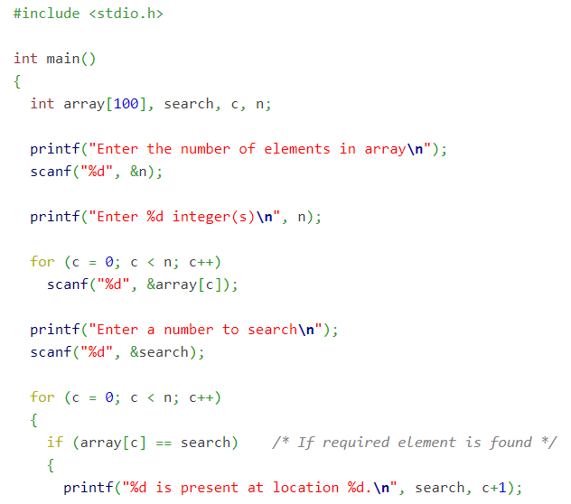
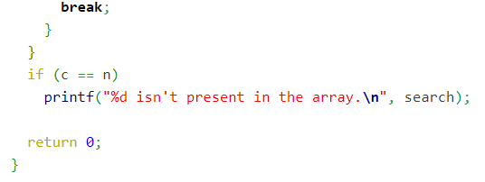
Linear search

